Slide 1
POV Project
Aim: Increasing the number of Young
People into Volunteer opportunities through the Arts
and capturing the voice of the Young People
Stephanie Henry: POV Project Manager

Slide 2
Keeping connected
Steering Group Meeting
Since the start of the project, organisations are seeing the true value of the POV project and the
difference it can make engaging with young people in this way; allowing them to be ‘the voice.’
From the start of the project lifespan, we have stayed well connected with organisational leads through regular emails and TEAMS,
As well as engaging in a bi-monthly Steering Group meeting. This is an opportunity for myself as Project Manager to address any
next steps as well as collective reflection on the reporting. Leads have made huge strides within the project and this is evident in the
Increase of young people accessing their locations:
In just 6 months, the project objectives of increasing 100 new volunteers into volunteering opportunities
has been met;
Since the start of the project a total of 112 new volunteers have been recruited across the partnership;
A total of only 8 young people have left the volunteer projects, equates to just 7%;

Slide 3
Keeping connected
Young People Advisory Group Meeting
Since the start of the project a meeting was formed to allow the voice of the
Young People to be truly captured.
The meeting takes place via TEAMS and includes young people from each partner organisation within the projects and myself as Project Manager.
It is crucial that no other leads are present to allow the young people to feel comfortable and confident enough to share their ideas.
The meetings are held on a monthly basis to ensure there is high momentum.
From the meetings, the Young People have impacted the POV project as follows:
Changing of the filming and editing elements of the project to be through their phones, not by adults;
Design of the filming and editing workshops ran by Junction Arts to support the above;
The development of the Discord Platform, to help support young people’s confidence in volunteering
opportunities;
The layout and structure of the POV website when accessing necessary information.

Slide 4
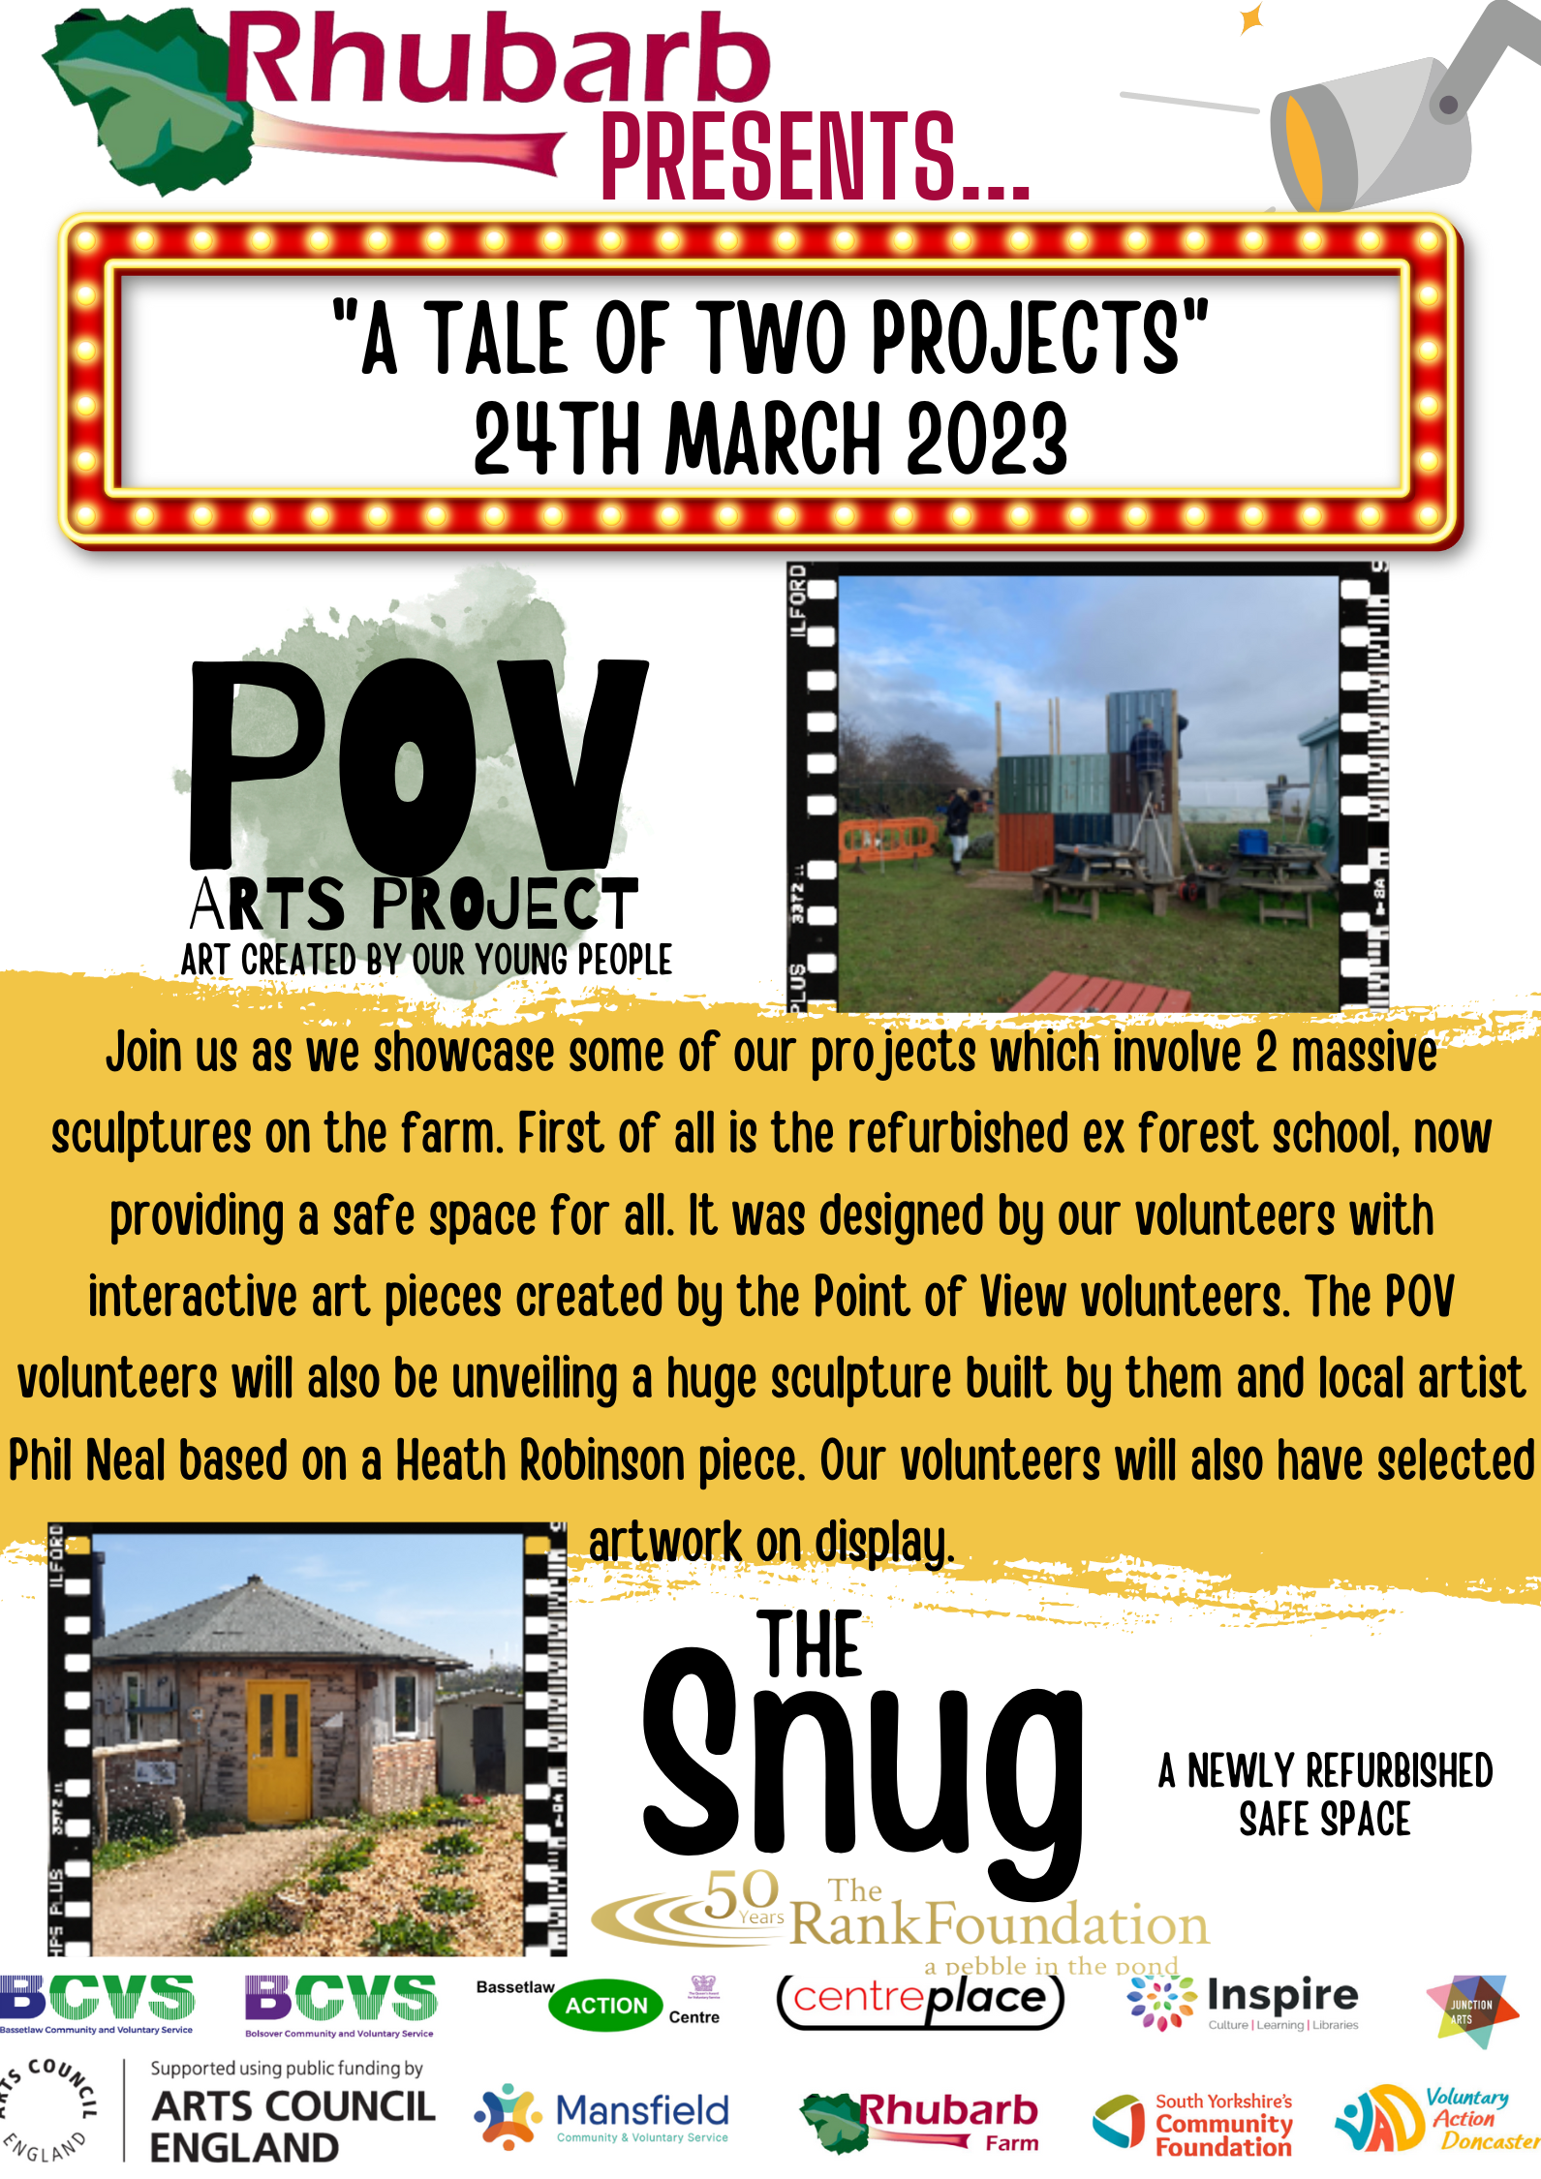
Some of the positives from the organisations involved…
Rhubarb Farm
The young people have worked together on a joint piece of art as well as being
encouraged to complete a solo piece of work. Allowing the young people, the
capacity to flourish with their own ideas has been crucial for Rhubarb Farm in
helping support the mental health and wellbeing of the young people. They are
already witnessing huge impact across the Farm through the POV project within
all work which has been pleasing to see. Flexible volunteering hours has also helped
and supported engagement and retention.
“This project has changed the whole “vibe” of the Farm for the better. We have
attracted more young people than ever before… I genuinely believe this project
is improving the site aesthetically by having sculptures, art works and safe
spaces designed and built by our volunteers.”
Ben Sofield – POV Lead at Rhubarb Farm

Slide 5
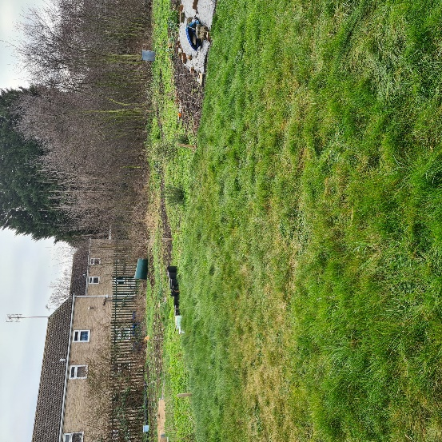
Some of the positives from the organisations involved…
Voluntary Action Doncaster
VAD have made a personal commitment to engaging 100 new young people through the
POV projects over the project lifespan. They have had a clear objective this quarter to hold
a mixture of activities including some of the following to gain maximum impact and
involvement of the young people. Holding of Graffiti workshops to showcase #ourpov
with up to 100 young people by an Arts professional. To facilitate opportunities
for younger people to access a local community hub where they have access to
music studio and DJ booth. They are also working alongside a local charity that provides
new drum kits for younger people who are in need, who would not have the opportunity
to access this equipment otherwise.
“Target Outcomes- to complete the above before spring 2023 & work alongside other
facilitators to produce a future monthly podcast by the younger volunteers about their
community using their knowledge from past activities provided.”
Jade Mitchell– POV Lead at Voluntary Action Doncaster

Slide 6
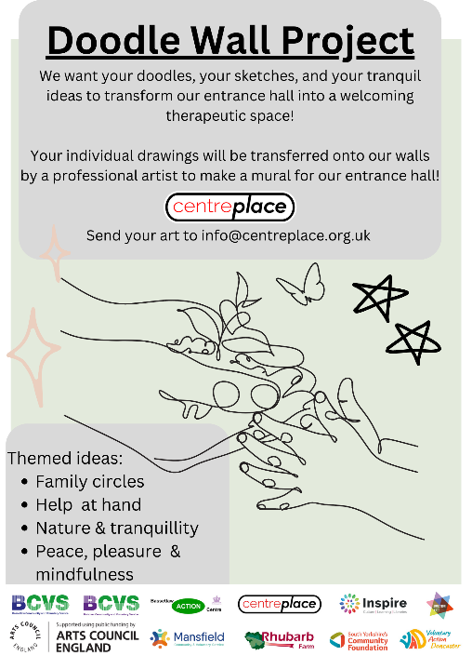
Some of the positives from the organisations involved…
Centre Place
Supporting their own young people and those from the other POV organisations
with their mental health with counselling (Talk Zone). Mental health and wellbeing has
been highlighted as an area of concern for all participating organisations with their new
volunteers therefore, we want to support the young people as much as possible.
They have also be contacted by the Children’s Bereavement Centre in producing a tangible
resource pack; Centre Place will be including the young people through the POV project
to support the creation of this document. This will include creation of the logo, mindfulness
colouring in and bookmarks as well as social media advertising.
“We are providing counselling support for all the young people involved in the wider project.
Outcomes - Young people and LGBT+ young people have ownership over the project and
feel engaged in their community.”
Georgia Crossland – POV lead at Centre Place

Slide 7
Filming & Editing from the Young People’s POV
As mentioned previously, the Young People were unified in their thoughts making the videos personal.
Therefore, films would be their phones and capture ideas around the following:
What volunteering means to me;
A day in the life of POV;
Them interviewing a fellow volunteer;
Videos aimed at parents;
One of the new volunteers from the start of POV.
At this moment of the project lifespan, all organisations are
watching and processing the content with their young people.
The next step is for the young people to begin recording and
sharing these together to create a larger recorded piece.

Slide 8
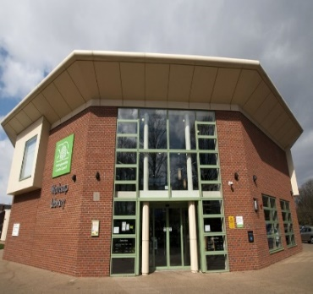
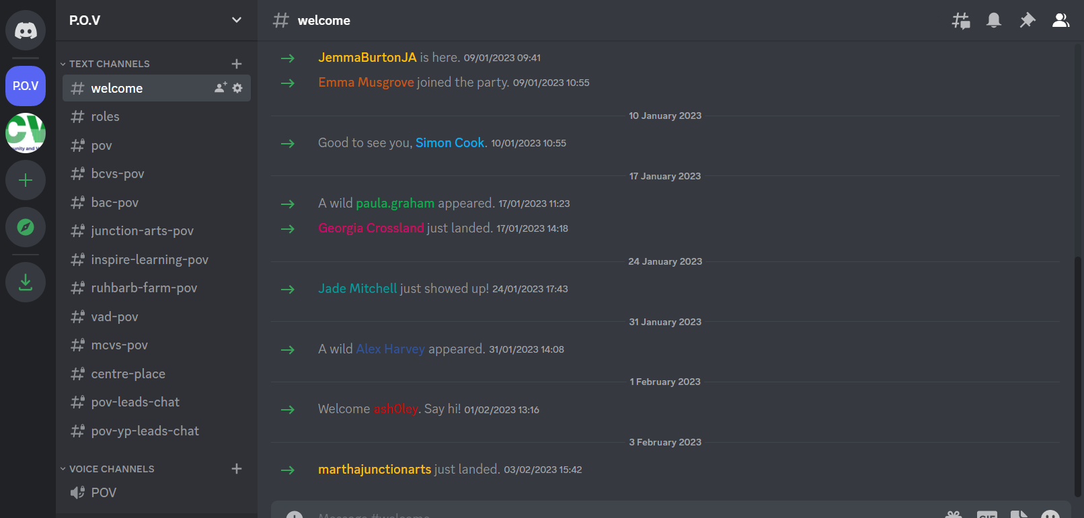
Further Developments:
POV exhibition May 2023 – Worksop Library
Through the POV project, lead from Inspire Learning Simon Cook has proposed the idea of an POV Art exhibition taking place at Worksop Library during May. The idea is for Inspire Learning’s young people to design and plan the exhibition and link with young people from the other 6 locations to display the work over the three days. There will be a planned private exhibition for all those within the POV project.
Discord Platform to support young people’s confidence into volunteering
Through surveys with the young people an area of focus has been around confidence being a firm barrier to young people accessing volunteering opportunities. Through the Advisory Group, the young people were able to suggest, plan and design the Discord Platform in order for all organisations to use as a mechanism to support young people into volunteering. This launched January 2023 and is very much in its infancy at this stage.

Slide 9
Steps to strengthen the POV project timeline…
Steps: | When:
Centreplace to support all 6 locations, and themselves, to support their young people with counselling sessions to support their mental health and wellbeing. Offering of in person visits too if needed. | End of project lifespan
A collection of 5 to 10 short films from all 7 organisations from the young people capturing the POV project through ‘their eyes’ on their mobile phones. | Dec 2023
Young people making full use of the Discord Platform on a daily basis and evidence of them supporting one another to access POV projects and wider volunteering opportunities. | Aug 2023
Inspire Learning to plan, run and showcase the POV project over the course of 3 days in May at the Library in Worksop. | May 2023
Project Manager to share and recognise the incredible achievements of the POV project across at the Newcastle event with the Arts Council and VFF in March. | 27th March 2023

Slide 10
Summary of key messages from the Young People’s Voice
Supporting young people’s mental health and wellbeing –
TalkZone through Centre Place have increased their provision.
Supporting confidence of the young people in accessing the
projects – Discord platform launched but early days.
Recognising volunteering they have achieved – tiered levels
Bronze, Silver, Gold and an awards evening.
Site that houses all help/advice/support/travel opportunities
into volunteering opportunities locally.

Slide 11
A day in the life of POV

