Slide 1
The Provider Selection Regime (PSR)
Draft Policy Reference Slides
Notes:
Standard title slide

Slide 2
The Provider Selection Regime (PSR)
Draft Policy Reference Slides
These reference slides are intended to support relevant authorities with their application of the new Provider Selection Regime (PSR); however, they are not exhaustive and should not be used as guidance. Relevant authorities must follow the regulations and associated statutory guidance when applying the PSR.
Throughout this slide deck requirements set out in the PSR regulations that relevant authorities must comply with are denoted by blue circles in the top left corner. The relevant regulations are inserted into the middle of the circle.
Throughout this slide deck recommendations by NHS England as set out in the statutory guidance are denoted by orange circles in the top left corner.

Slide 3
PSR implementation toolkit
This slide deck is aimed at senior managers who will need to have some understanding of the PSR, but who will not themselves be applying the PSR day-to-day. This slide deck is part of the PSR implementation toolkit, containing the following:
Overview slide deck, providing a quick introduction to the PSR and is aimed at senior leaders
Policy slide deck, providing some more detail about the key features of the PSR and is aimed at commissioners and procurement leads
Practitioner slide deck (this one), providing in-depth information about the steps in the PSR processes and is aimed at practitioners
End-to-end process maps for all provider selection processes in the PSR, aimed at practitioners
FTS guide, providing information about which notices need to be published on FTS and is aimed at practitioners
Flow-charts, providing a visual representation of some of the key processes in the PSR.

Slide 4
PSR implementation toolkit
These slides cover:
The aims and scope of the PSR, and the new flexibilities that it offers.
What the different provider selection processes are and when to apply them.
The transparency requirements and the need for robust record keeping.
Details of the new regime’s five ‘key criteria’.
What ‘mixed procurement’ is and when it might be used.
What ‘permitted contract modifications’ are.
How provider selection decisions are reviewed under the PSR.
The transitional arrangements.

Slide 5
Introduction
This policy webinar is part of a wider toolkit aiming to help organisations to implement the PSR. Other resources are:
The Health Care Services (Provider Selection Regime) (England) Regulations 2023
1.
The PSR statutory guidance
2.
Practitioner webinars (upcoming)
3.
Find a Tender Service (FTS) guide
4.
Frequently Asked Questions document (FAQs)
5.
PSR toolkit, including end-to-end process maps for selection processes
6.

Slide 6
What do you need to know?
The Health and Care Act 2022 introduced a new procurement regime for selecting providers of health care services in England: the Provider Selection Regime (PSR).
The PSR has been designed to introduce:
a flexible and proportionate process for selecting providers of health care services so that all decisions are made in the best interest of people who use the services
1.
the capability for greater integration and enhanced collaboration across the system, whilst ensuring that all decisions about how health care is arranged are made transparently
2.
Opportunities to reduce bureaucracy and cost associated with the current rules
3.

Slide 7
Legislative changes
Regulation 2
The PSR is intended to come into force on 1 January 2024 and will replace the:
Public Contracts Regulations 2015, when procuring health care services
National Health Service (Procurement, Patient Choice and Competition) Regulations 2013
Organisations, referred to as ‘relevant authorities’ under the PSR, are required to follow the PSR when arranging health care services, irrespective of whether the providers they are considering are from the NHS, the independent, or the voluntary sector. Relevant authorities are:
NHS England
Integrated Care Boards (ICBs)
NHS trusts and foundation trusts
Local authorities or combined authorities.
Relevant authorities must continue to comply with other legal obligations and duties.

Slide 8
Procurement principles
Regulation 4
Relevant authorities must act:
with a view to secure the needs of the people who use the services, including through integrated service delivery
1.
with a view to improve the quality of the services, including through integrated service delivery
2.
with a view to improve the efficiency of the services, including through integrated service delivery
3.
Transparently, fairly, and proportionately.
4.

Slide 9
Scope
Regulation 3
Schedule 1
The PSR will apply to the arranging of health care services in England.
Broadly, services within scope are:
services that provide treatment, diagnosis or prevention of physical or mental health conditions to individuals or groups of individuals (i.e., patients or service users) such as hospital, community, mental health, primary health care, palliative care, ambulance, and patient transport services for which the provider requires CQC registration
substance use treatment services, sexual and reproductive health, and health visitors arranged by local authorities.
Examples of procurements not in scope of this Regime:
goods (i.e., medicines, medical equipment)
social care services
non-health care services or health-adjacent services (i.e., capital works, business consultancy, catering) that do not provide health care to an individual.

Slide 10
Mixed procurements
Regulation 3
The PSR allows relevant authorities to arrange a contract comprising of a mixture of in-scope health care services and out of scope services or goods when both of the below statements are true:
The main subject matter of the procurement is relevant health care services in England.
This means that the health care service element must be more than 50% of the value of the contract.
1.
The relevant authority is of the view that the other goods or services could not reasonably be supplied under a separate contract.
This means that the relevant authority is of the view that procuring the health care services and the other goods and services separately would, or would be likely to, have a material adverse impact on the relevant authority’s ability to act in accordance with the procurement principles.
2.

Slide 11
Making a decision
Regulation 6
Relevant authorities must identify which provider selection process is applicable for the health care service they are arranging.
The processes are:
Direct award processes: A, B, and C
Most suitable provider process
Competitive process

Slide 12
Overview of the decision-making circumstances
Regulation 6
Direct award processes
The most suitable provider process
The competitive process
A
B
C
Allows the relevant authority to make a judgement on which provider is most suitable based on consideration of the key criteria. Award without competitive tender.
Where the relevant authority cannot use any of the other processes or wishes to run a competitive exercise.
The existing provider is the only capable provider.
People have a choice of providers, and the number of providers is not restricted by the relevant authority.
The existing provider is satisfying the existing contract and will likely satisfy the proposed new contract, and the contract is not changing considerably.

Slide 13
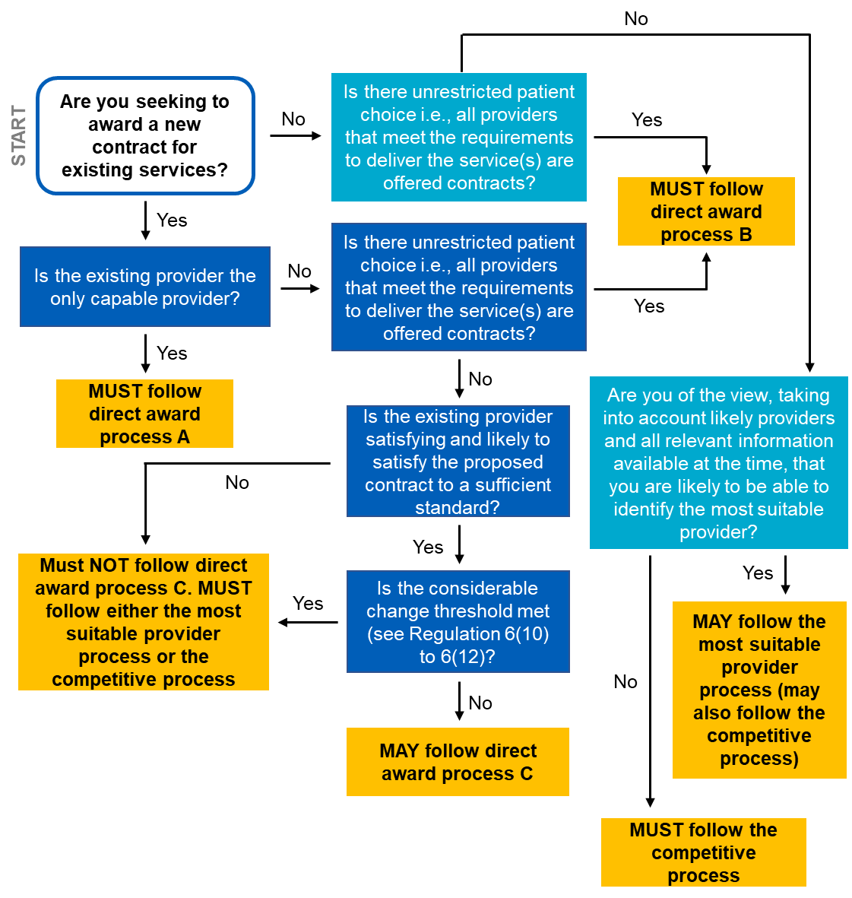
Getting to the right decision
Regulation 6

Slide 14
Framework agreements
Regulation 16
Regulation 17
Regulation 18
Relevant authorities may establish framework agreements under the PSR to arrange in-scope health care services. To note:
Establishment of the framework agreement must follow the competitive process.
1.
2.
After a framework agreement has been established, relevant authorities that are party to the framework agreement may award contracts to providers also party to the agreement.
Relevant authorities can award contracts based on a Framework Agreement in two ways:
1. Without competition, so long as this is provided for in the terms and conditions of the Framework Agreement.
Following the Competitive Process
Relevant authorities can award contracts based on a framework agreement in two ways:
without competition, so long as this is provided for in the terms and conditions of the framework agreement.
mini-competition, in line with the competitive process.
3.
3.

Slide 15
Key criteria
Regulation 5
There are five key criteria that must be considered when assessing providers under direct award process C, the most suitable provider process, or the competitive process.
These are:
Quality and innovation
1.
Value
2.
Integration, collaboration, and service sustainability
3.
Improving access, reducing health inequalities, and facilitating choice
4.
Social Value
5.

Slide 16
Key criteria
Regulation 5
When assessing a provider against the key criteria, all five key criteria must be considered, and none should be discounted. However, the relative importance of the criteria is not pre-determined and there is no prescribed hierarchy or weighting for each criterion.
Example 1: Equal weighting
Example 2: Unequal weighting
Example 3: Pass/Fail
Social value | 20%
Improving access, reducing health inequalities, and facilitating choice | 20%
Value | 20%
Integration, collaboration, and service sustainability | 20%
Quality and innovation | 20%
Social value | 15%
Improving access, reducing health inequalities, and facilitating choice | 15%
Value | 25%
Integration, collaboration, and service sustainability | 20%
Quality and innovation | 25%
Social value | 10%
Improving access, reducing health inequalities, and facilitating choice | 50%
Value | Must meet minimum standard
Integration, collaboration, and service sustainability | 40%
Quality and innovation | Must meet minimum standard

Slide 17
Transparency requirements
Schedules
2-14 Regulation 24
Regulation 25
The PSR provides for greater flexibility and allows relevant authorities to award contracts without using a competitive process, where appropriate. This means that other checks and balances need to be in place to ensure that the PSR is complied with and that the flexibilities are used appropriately and in the best interest of service users.
The PSR therefore requires that:
1.
Transparency notices are published when contracts are awarded and in some situations before contract awards are made.
2.
Relevant authorities keep detailed evidence of their decisions and decision-making processes, which they may be required to share with providers (if they receive a representation).
3.
An annual summary is published, which details how many contracts were awarded using the various provider selection processes.

Slide 18
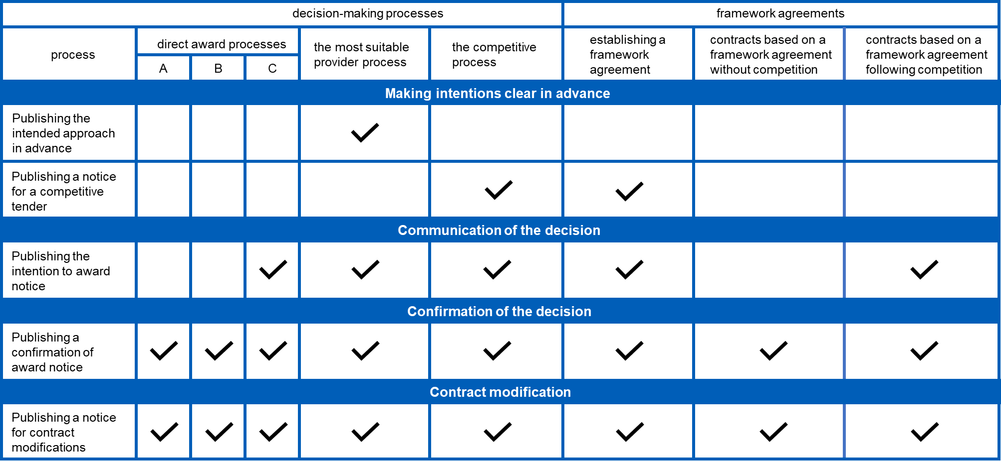
Transparency requirements
Schedules 2-14

Slide 19
Record keeping
Regulation 24
Relevant authorities must keep records of their considerations throughout the award process. These records may be requested as part of a review during the standstill period. Records must include:​​
the relative importance of each of the key criteria and the rationale for their relative importance and how the basic selection criteria were assessed
name and address of the provider
the decision-making process followed to select a provider​
the rationale for the decision
for mixed procurements, how the procurement meets the requirements for mixed procurement
details of the individual/individuals making the decision
any declared or potential conflicts of interest for individuals involved in decision making and how these were managed

Slide 20
Reviewing decisions during the standstill period
Regulation 12
When following direct award process C, the most suitable provider process, and the competitive process – following the publication of the Intention to Award a Contract – the relevant authority must observe the standstill period.
It is a period of eight working days (which may be extended) during which representations can be made and must be responded to.
The standstill period allows the relevant authority to consider any representations received and to respond as appropriate. The relevant authority must allow the provider five working days to consider their feedback before closing the standstill period.
The standstill period should be extended (unless in exceptional circumstances) if the representation is considered by the PSR Review Panel.

Slide 21
Reviewing decisions during the standstill period
Regulation 12(3)
Regulation 12(4)
Relevant authorities are only obliged to respond to representations if:
The representation comes from a provider who might otherwise have been a provider of the services to which the contract relates.
1.
The provider is aggrieved by the decision of the relevant authority.
2.
The provider believes that the relevant authority has failed to apply the PSR correctly and they are able to set out reasonable grounds to support their belief.
3.
The representation is submitted in writing to the relevant authority.
4.

Slide 22
The standstill period: representations
Regulation 12 Regulation 24
Guidance
If a representation is received, then the relevant authority:
1
must ensure that the provider has been afforded the opportunity to explain or clarify their representation
2
is expected to provide an indicative timeframe for when the representation might be considered by
3
must provide any information requested by the provider that the relevant authority is required to keep under Regulation 24
4
must consider the representation(s) made, and review evidence and information used to make the original decision
5
must consider whether the representation has merit i.e., in identifying that process has not been correctly followed
6
must decide whether to return to an earlier step, abandon the process, or award the contract as originally intended
7
must communicate the decision promptly to all interested parties, and wait at least five working days before closing the standstill period,

Slide 23
Standstill period: the PSR Review Panel
Guidance
Throughout the standstill period, there should be ongoing communication between the relevant authority and provider about the representations that were made.
If the provider remains unsatisfied with the response of the relevant authority to its representation and remains of the view that the PSR has not been applied correctly, the provider may submit a representation to the PSR Review Panel.
The panel will be an independent panel, made available by NHS England. It will review representations made by a provider and will share their advice with the relevant authority about whether they applied the PSR correctly.
The standstill period should not be closed (unless in exceptional circumstances), and the contract awarded, until the panel has concluded their review.

Slide 24
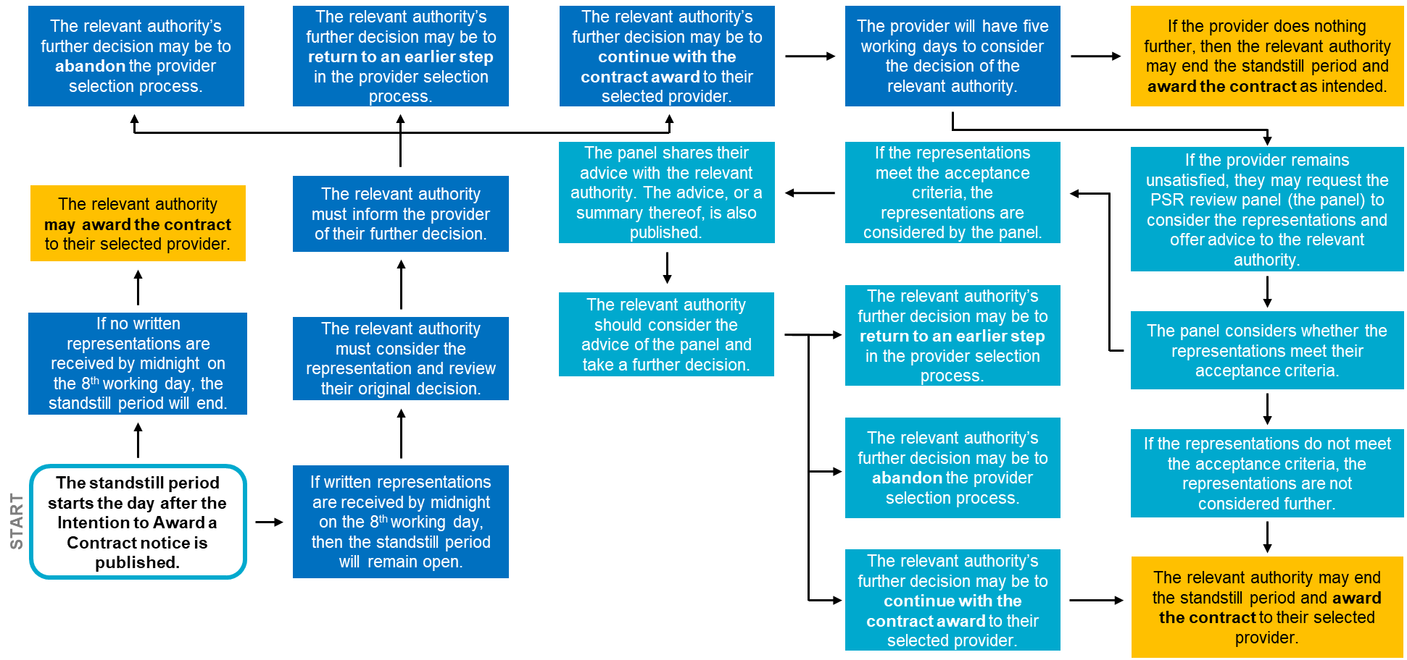
Reviewing decision during the standstill period
Regulation 12
Guidance

Slide 25
Contract modifications
Regulation 13
Modifications are permitted under the Regime, if the modification is:
1.
1.
Clearly and unambiguously provided for in the original contract
If this modification is £500,000 or over and is attributable to the relevant authority, then a transparency notice must be published.
2.
2.
Solely a change in the identity of the provider
If this modification is £500,000 or over and is attributable to the relevant authority, then a transparency notice must be published.
Made in response to external factors beyond the control of the relevant authority and the provider, such as changes in patient or service user volume or changes in indexing; but do not render the contract materially different in character.
3.
If this modification is £500,000 or over and is attributable to the relevant authority, then a transparency notice must be published.

Slide 26
Contract modifications
Regulation 13
Modifications are permitted under the Regime, if the modification is:
Attributable to the relevant authority, does not render the contract materially different in character, and the change in the lifetime value of the contract, compared to its value when it was entered into, is UNDER £500,000 AND represents less than 25% of the original contract value.
1.
4.
A transparency notice is not required.
2.
5.
Attributable to the relevant authority, does not render the contract materially different in character, and the change in the lifetime value of the contract, compared to its value when it was entered into, is OVER £500,000 AND represents less than 25% of the original contract value.
A transparency notice must be published in these circumstances.
Made to a contract that was originally awarded under direct award process A or direct award process B and the modification does not render the contract materially different in character.
6.
If this modification is £500,000 or over and is attributable to the relevant authority, then a transparency notice must be published.

Slide 27
Contract modifications
Regulation 13
Modifications are NOT permitted under the Regime, if the modification is attributable to a decision made by the relevant authority and:
The changes render the contract materially different in character
or
The changes are OVER £500,000 AND represent OVER 25% of the original contract value.

Slide 28
Urgent situations
Regulation 14
There are a small, limited number of occasions where relevant authorities may need to act urgently in an emergency. Urgent circumstances include where:
Acting rapidly in an unforeseen emergency that is not attributable to the relevant authority; local, regional or national crisis. For example, to deal with a pandemic.
Urgent quality and/or safety concerns that pose risks to patients or service users, and necessitate rapid changes (where it would not be feasible to undertake a provider selection process).
The existing provider is suddenly unable to operate and a new service provider needs to be identified.
Relevant authorities must carry out a full provider selection process once the emergency has passed. If this time period is over 12 months, then a justification must be provided.

Slide 29
Contract award procedures started before 1 January 2024
Regulation 29
All contract award processes commenced on or after 1 January 2024, must use the PSR, including awards based on an existing framework agreement.
All contract modifications on or after 1 January 2024, including to existing contracts, must follow the PSR rules.
Contract award procedures commenced before 1 January 2024, including when awarding a contract based on a framework agreement, must conclude under the current rules. This applies even if the process is ongoing and completed after the PSR has taken effect.
Contract award procedures commenced before 1 January 2024 may be abandoned under the regime they were commenced under. We recommend that any relevant authorities considering this should take legal advice before doing so.

Slide 30
Contract award procedures started before 1 January 2024
Regulation 29
A contract award process is considered to have started under the PCR is any of the following occur before the PSR comes into forces:
a contract notice has been submitted to the UK e-notification service for publication in accordance with Regulation 51(1) of the Public Contracts Regulations 2015
the relevant authority has contacted any provider to seek expressions of interest or offers in respect of a proposed contract
the relevant authority has contacted any provider to respond to an unsolicited expression of interest or offer received from that provider in relation to a proposed contract.

Slide 31
Further Resources
If you have any questions, please contact psr.development@nhs.net.

