Slide 1








1
3
4
2
How do you feel? Tell the person next to you, which image represents you today, and why?
7
8
6
5
Notes:
Follow up with WHY we do this

Slide 2

Using co-production and outreach approaches to find and engage with people in your communities
Jennie Shrewsbury
Good Practice Mentors

Slide 3
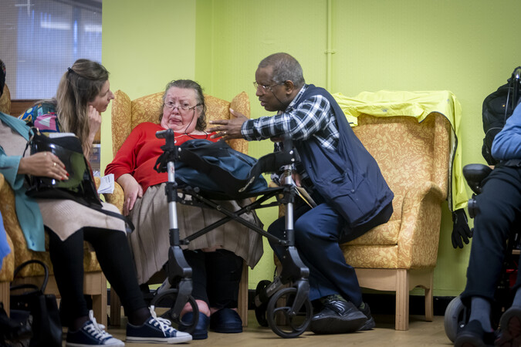
The importance of setting the scene
We start our sessions with an activity that encourages everyone in the room to take part
Research tells us that the sooner people talk in a session, the more likely they are to continue engaging as we continue
By using something creative, and unrelated to roles within the room, everyone is introduced at the same ‘level’
An image-based activity requires limited verbal ability so is perfect for those who are less confident, have English as a second language or who are non-verbal for other reasons
Notes:
Follow up with WHY we do this

Slide 4
Today’s session
Explore an introduction to different co-production models and principles and reflect on how these apply to our work
Consider how we build trust with our communities
Explore how we set the scene for co-production to happen and challenge power imbalances
Think about different methods for bringing diverse voices into your co-production work
An opportunity for reflection, discussion and questions
Signposting to further support and resources from the Good Practice Mentors

Slide 5

What does co-production mean to you?
1 minute
Notes:
Group discussion – write down your answer on a piece of paper but don’t share. We will revisit at the end of the session.

Slide 6
Here are a few examples from us…
Notes:
Group discussion – write down your answer on a piece of paper but don’t share. We will revisit at the end of the session.

Slide 7
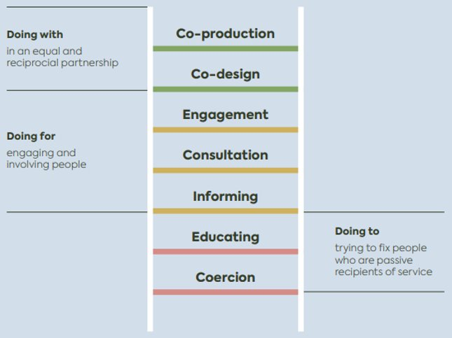
It’s all about involving people & how we do that..

Slide 8
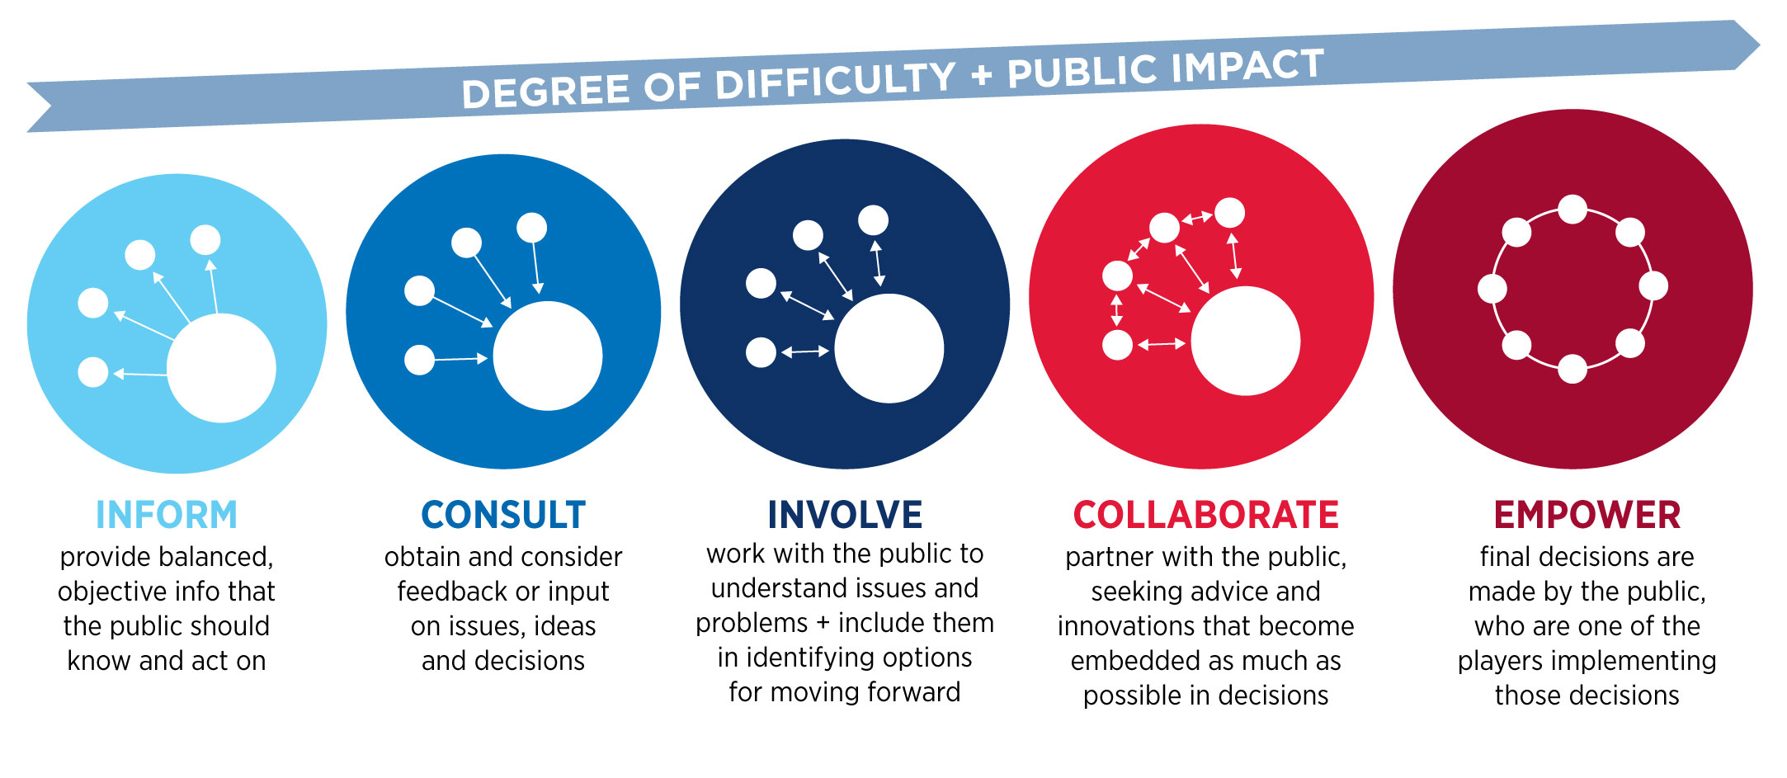
The spectrum of involvement

Slide 9
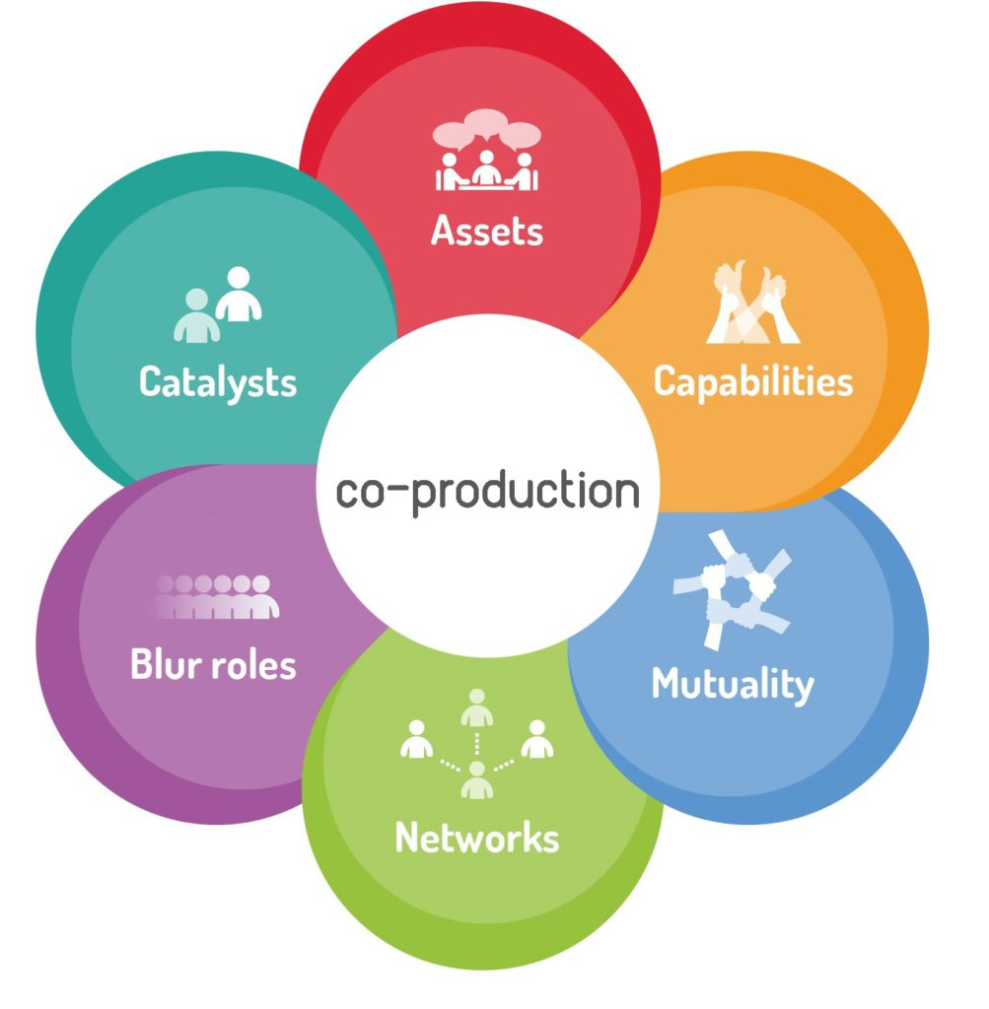
Co-production is...
“The term co-production refers to a way of working where service providers and users work together to reach a collective outcome.
The approach is value driven and builds on the principle that those who are affected by a service are best placed to help design it.”
Mind

Slide 10
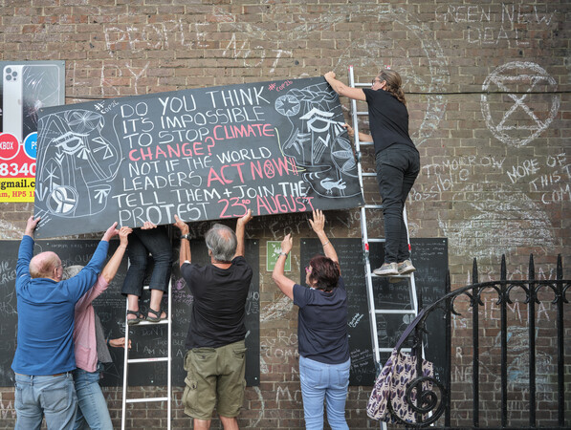
Co-production is…
Designed to build on people’s existing capabilities- To seek out what they can do not just define people by what needs fixing
Reciprocal relationships between professionals and clients, or services and communities
Encouraging mutual support networks among users to take over once professional help moves on (Which it almost always does)
Blurring distinction between professionals and service users
Recognising users as assets to the services
(David Boyle, 2011)

Slide 11
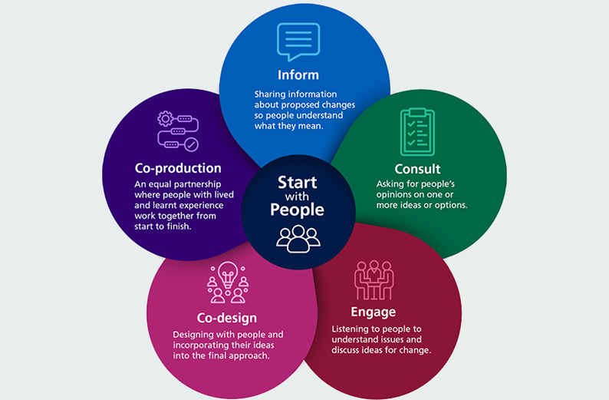
Putting people at the centre and including them in different ways..

Slide 12
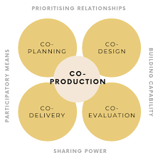
The elements of co-production

Slide 13
The Principles
Equality: Everyone has something to offer and is given an opportunity to contribute. No group or individual has more influence than another.
Diversity: Ethnic minorities, communication abilities, people who need more support, people with different experiences, people who are unaffiliated to support
Accessibility: Physical space, information & comms, time, jargon free
Reciprocal: Financial, creating something together, skills development, building confidence and personal value
Notes:
Equality
Framing this in community groups – every member has a skill or resource they can bring to the table. How can you help people explore what assets they bring that can add to the group? Do people feel they are bringing themselves to the group? Are they there to do with or are they being done to? Are people helping identify activities they want to engage in? Are people taking part in the set up and running of the sessions?
Diversity
Often in community groups we can see the same faces attending or taking the lead – how can you involve new people in conversations? Are you taking an approach that ensures that everyone feels welcome and supported to speak? Do they see themselves represented in the way those conversations are being run? Are you allowing enough time for people who need more support to engage and communicate? Are you using a range of activities to invite involvement?
Accessibility – this is not just about physical accessibility although that is important, but it’s about that space feeling accessible – is that an environment where everyone feels comfortable or does it alienate certain people? Have you considered how it might alienate certain groups that you aren’t part of? Co-production is usually done best in the environments where people feel comfortable and if you’re inviting them into a new space, you need to do some work to help them relax in that space. Accessibility also refers to things like language used – are you making sure that everyone can understand what you are trying to communicate?
Have you considered the people you aren’t reaching – if you’re trying to reach working age older people, are they at work when you want them to be engaging? Have you considered how to be flexible in the times you run things? If you can’t be flexible, how else can you invite their voice into the conversation?
Reciprocal – this is about everyone benefiting from the process. Everyone who takes part should be getting something back from their experience – this cannot be one size fits all by the very nature of co-production. If you are using people to develop and design services, how will you give people something back for their time? Financial? Skills development? Food? Vouchers? Referrals to something that is meaningful to them? At the very least, this should be about acknowledgement and thanks and closing the loop. Accepting people’s thoughts/views and involvement and acknowledging it, both good and bad. The next best step is then telling them what will happen with that information and THEN letting them know when it has happened or if it hasn’t why – closing the loop should happen more than once!

Slide 14
To discuss on your tables…
What are the benefits of using co-production?
For:
Our Communities
Professionals
Services
What are the barriers to doing co-production?
Where do you think you are on your participation journey? Doing To, Doing For, or Doing With?

Slide 15
None of these are the wrong approach - find the best fit
If you already know where you’re ending up, it’s probably not co-production
But, Informing, consultation and engagement can still be guided by co-production principles
Be honest about which one it is and use that to your advantage
Not every stage of a journey must fall in the same part of the ladder
Which bits will be fixed and which will be flexible?

Slide 16
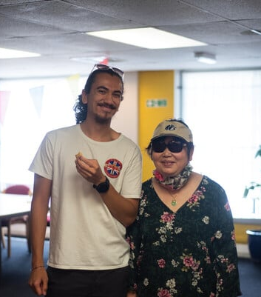
Creating space for co-production

Slide 17
Creating space for co-production
What needs to happen for our communities to work with us?
What are you already doing well to build trust with your communities?
How do you create spaces where people feel they can speak openly and honestly?

Slide 18
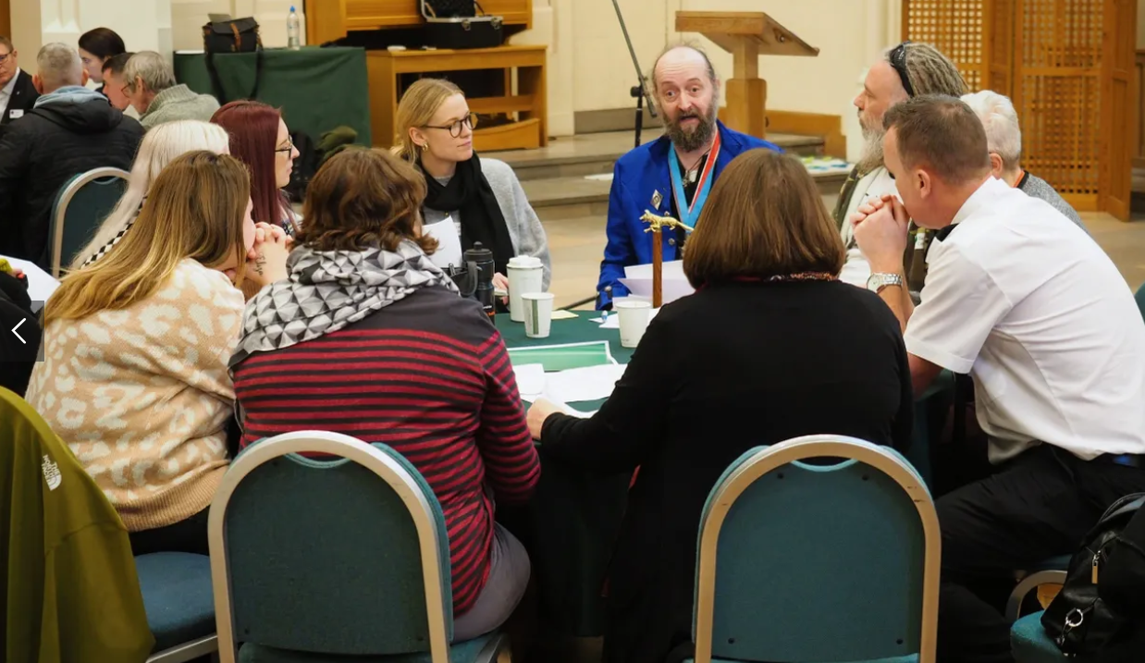
Power sharing
How have you felt when power has been taken away from you?
Why are power dynamics so important in co-production?
What are the signs (subtle or not subtle) of holding on to power?

Slide 19
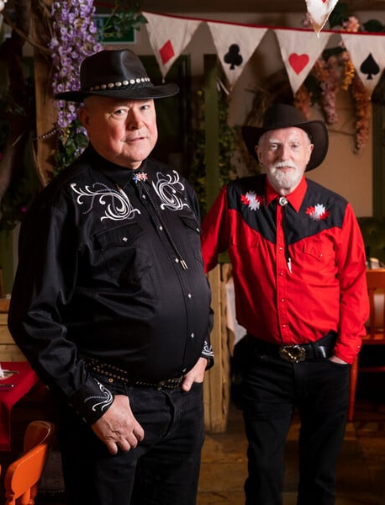
Creating space for power sharing
Removing power dynamics – is the space neutral and welcoming? Has everyone got the same ‘permission’?
Challenging yourself – How do you feel not being ‘in control’? Are there any subtle signs of power in the space?
Confidence building – Spend time setting the scene and creating group cohesion. People are more likely to speak later if they talk early on. Removing the ‘social risk’ of being the ‘different’ voice
Recognising people’s strengths – What roles can people take on to help them feel valued?

Slide 20
Leadership
Provides all the structure, and ensures decisions and actions are assigned
Makes final decision alone and without including others
Takes away all the actions to do themselves
Withholds certain information they see as not relevant or not possible to be shared with everyone involved
Facilitation
“Guide on the side”, not the “sage on the stage”
Fostering collaboration, asking questions, and ensuring all voices are heard
Nurtures creative discussions, encourages exploration of ideas, and guides towards consensus or decisions
Take a more ‘neutral’ approach to decision making

Slide 21
Who should be in the room?
Who are the ‘gatekeepers’ to different communities? How can you use these relationships to access more diverse voices?
Don’t reinvent the wheel – what already exists that you can join? How can you use existing groups or spaces to share your message or invite voices into your conversation?
Are you the right person to be having the conversation? Consider the importance of people seeing themselves in the conversation
Where are you having these conversations? Consider how comfortable people feel in different spaces. Do they come to you, or do you go to them?

Slide 22
Closing the Loop
Co-production is a process of building trust with the people involved
This should be part of the co-production journey throughout
To maintain trust, we must communicate outcomes of the process, good and bad
If we don’t close the loop, we damage trust and relationships
How might we might close the loop? – verbally, in writing, visually, next steps, future actions/plans…

Slide 23
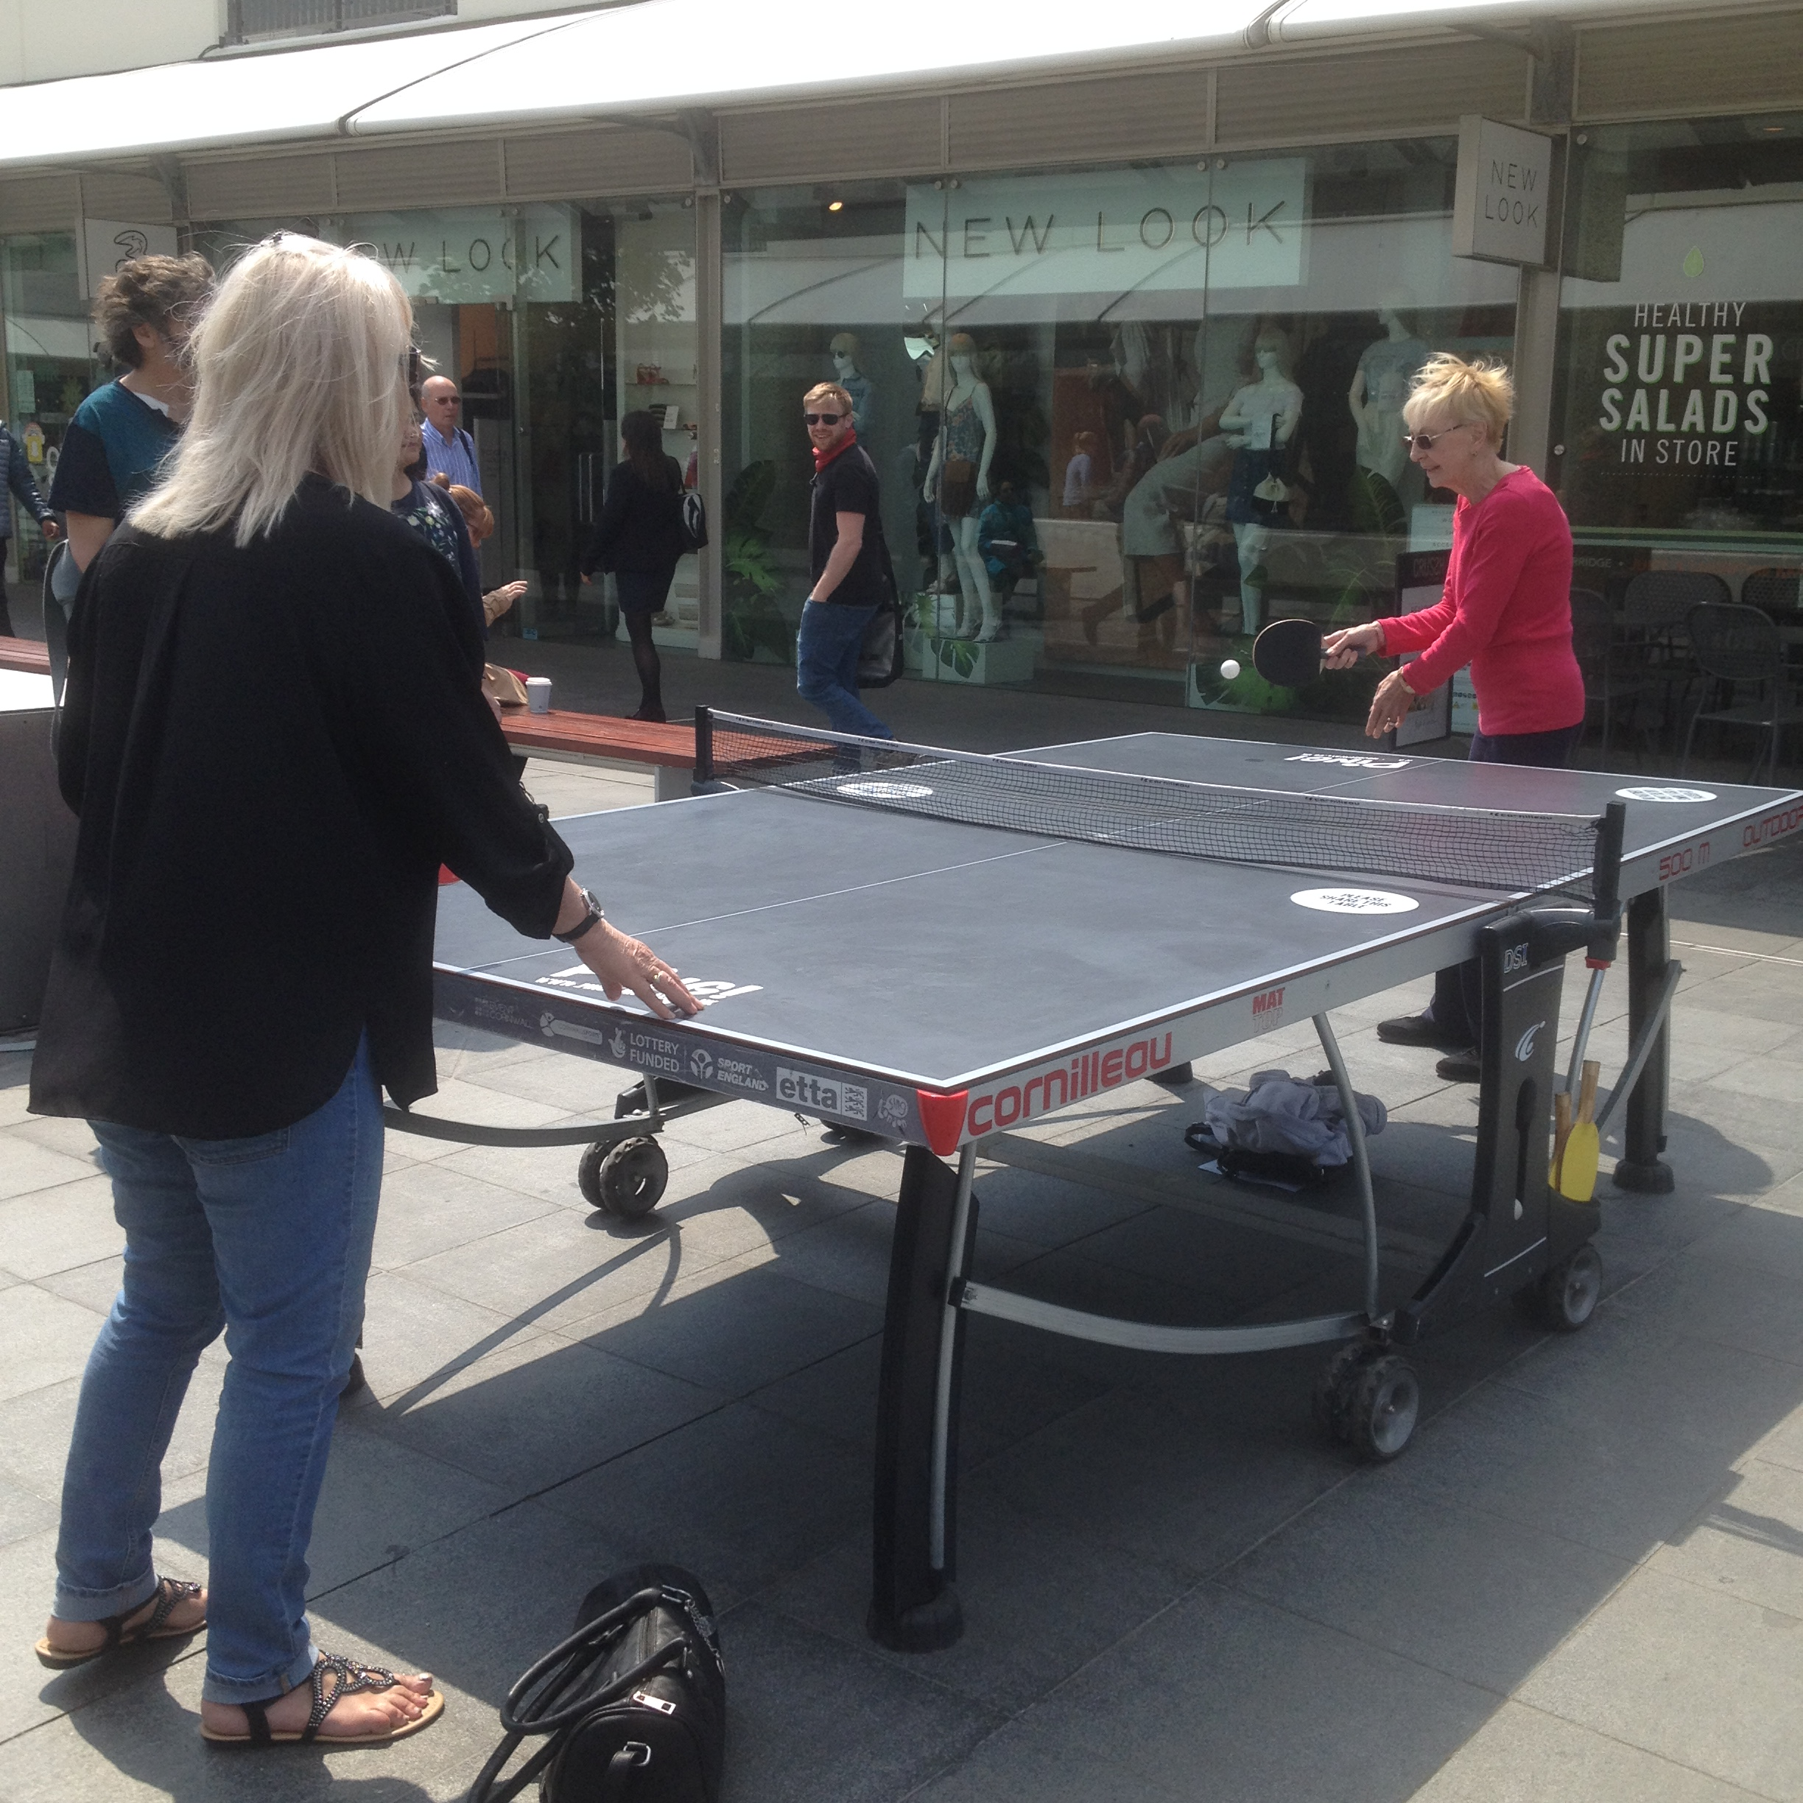
Finding and reaching the people we don’t hear from

Slide 24
Who are the people in your community who are seldom heard from?
What barriers might be in place to stop these people from engaging?
What methods do you already use to find these seldom heard voices?

Slide 25
Using Outreach approaches to find people in the community
Proactive - finding & meeting people out in the community by going to the spaces & places people are
Systematic – finds & engages everyone including the people ‘no-one knows’
Removes many of the barriers to engagement
Responsive, interactive, informal, light touch approach enables engagement with people reluctant to access formal services.
Puts information into the hands of people who aren’t contemplating or looking to joining activities.

Slide 26
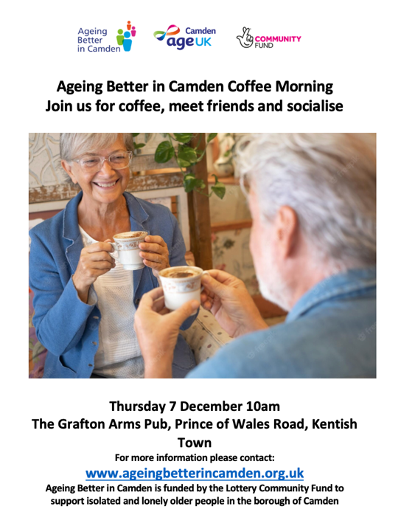
What does this piece of comms tell us about:
What the event is?
Who it’s for?
What to expect?

Slide 27
Descriptor of activity ‘coffee morning’ can lead to preconceptions
‘Meet friends and socialise’ may trigger social anxiety
Image leads people to disconnect if they don’t self identify with the people pictured
Lack of information (assumes people know where the venue is)
No information about what to expect
Signpost to website for more information – barrier for people without skills/access to online information, literacy issues, ESOL speakers etc.
Mention of loneliness and isolation in the strapline reinforces preconceptions that this is an activity for vulnerable people
Who does it seem to be for?

Slide 28
Producing comms to promote your activity
/offer
Key tips and learning: Be mindful of reinforcing negative preconceptions and barriers – is your offer pitched at ‘vulnerable’ people?
Use clear transactional language (does what it says on the tin) to describe the opportunity e.g. describe a ‘coffee morning’ as drop by for a free coffee and meet your neighbours.
Don’t assume that everyone will know what the activity is; if accessible to all, describe it.
Avoid references to ‘elderly’ ‘older people’, ‘later life’, loneliness, isolation and vulnerability 55+ is clearer and removes assumptions about who and what ‘older people’ means.
Keep tone casual and informal e.g. ‘drop-by’ Avoid references to formal sounding clubs or groups and social risk/commitment: e.g make friends, have fun, socialise.
Anticipate questions; what, why, where, when, who? include this information in the flyer.
Provide images of the pop-up location (inside and out) and a map with clear travel directions
Provide a contact name and telephone number. Don’t assume internet access or ability to contact you online.
Be mindful of the impact of images/representations of older people (see https://ageing-better.org.uk FREE age friendly image library)

Slide 29
Asset Mapping
Helping you consider where the naturally occurring spaces are in your community that can support your work
What strengths and opportunities already exist in your community and how do you engage with them?
Consider the physical, social, and networking opportunities in your community
How can you use these assets and strengths to continue to build robust networks in your community?
These are the places you need to go!

Slide 30
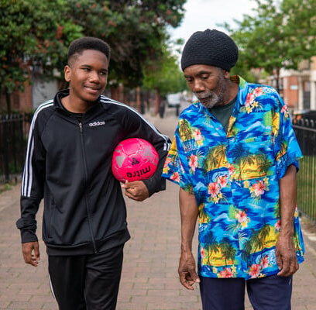
Summary
There is no one way to think about involvement, instead focus on the principles and setting the scene
Before you set off, decide what’s fixed and what’s flexible and be honest about this
Maintain trust by closing the loop
Consider which voices are missing from your conversations and how you can use informal, stepping stones, towards engagement

Slide 31
What does co-production mean to you now?
Would you change your first answer?

Slide 32
How can GPM support you?
We’re funded until March 2026 to offer a range of support addressing loneliness and social isolation
We offer a rolling programme of Eventbrite workshops – come along to get a more in-depth picture of the work we do
We can work with you to deliver bespoke sessions, either online or in person
All our work can be tailored to fit your unique circumstances, and provide support for a little or a long time!
Get in touch to find out more – details on the next slide

Slide 33

How to get in touch
For general enquiries and further
questions email our central inbox
gpm@syha.co.uk
Find details of future GPM sessions here:
https://www.eventbrite.com/o/thegood-practice-mentor-team-66357714073
Linkedin
X

