Slide 1
Website

Slide 2
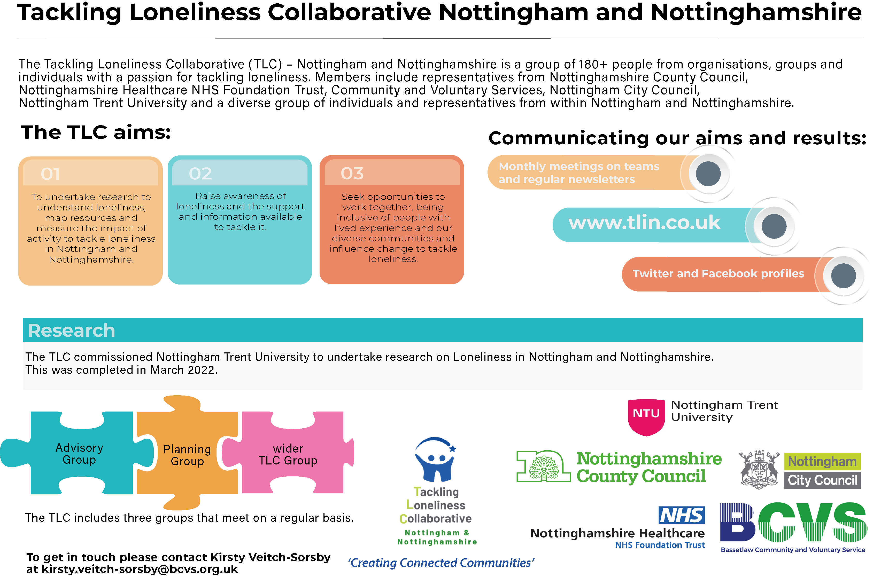
TLC Background

Slide 4
Why Do We Need Another Website?
The TLC is here to:
Raise awareness of loneliness
Gather evidence about loneliness and what works to tackle it
Influence strategies, activity and funding to help tackle loneliness
Having personally been involved with the Tackling Loneliness Collaborative for over 2 years, we have spent a lot of time speaking with people across the City and the County.
There are some brilliant and information websites available, we want to ⭐ champion ⭐ them and share information!
So, how can we be helpful? By being a ‘directory’ that is a quick way to link you
to services that can help you…

Slide 7
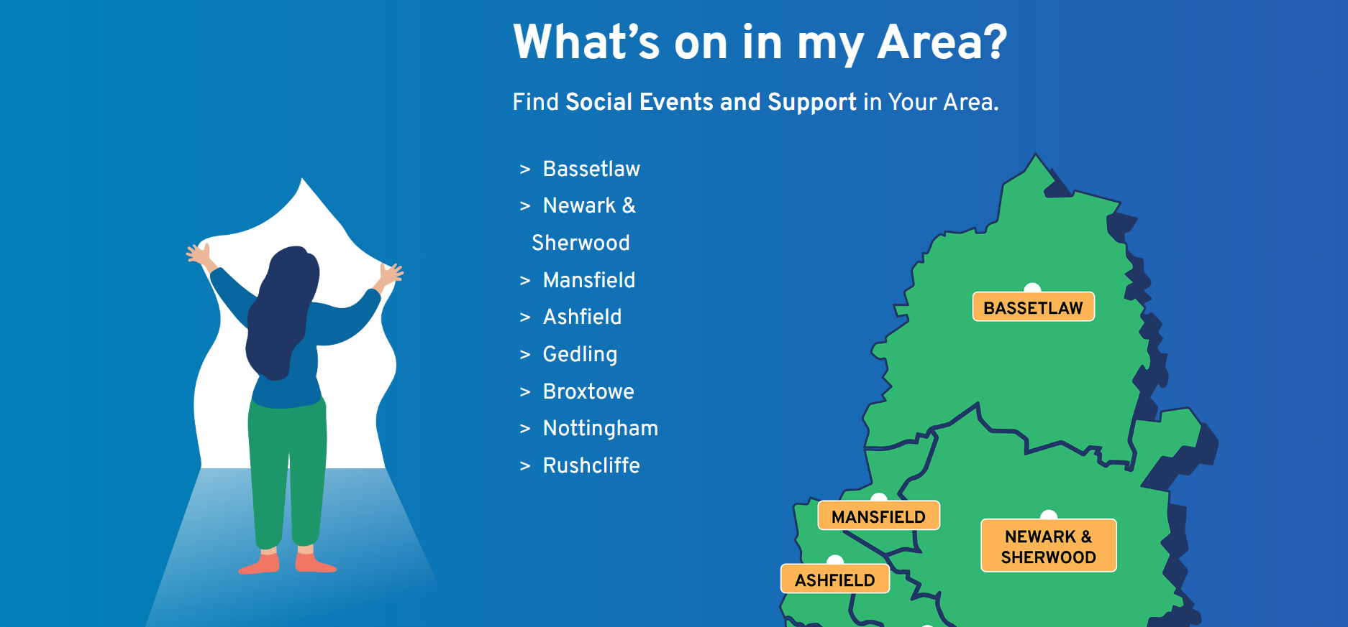

Slide 8
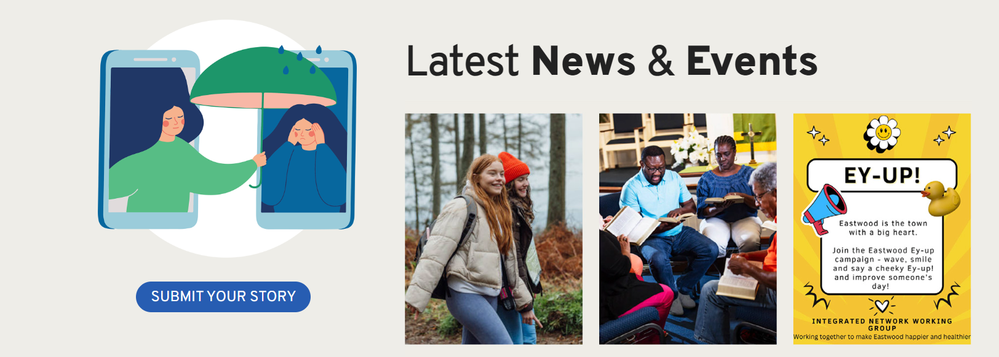

Slide 9
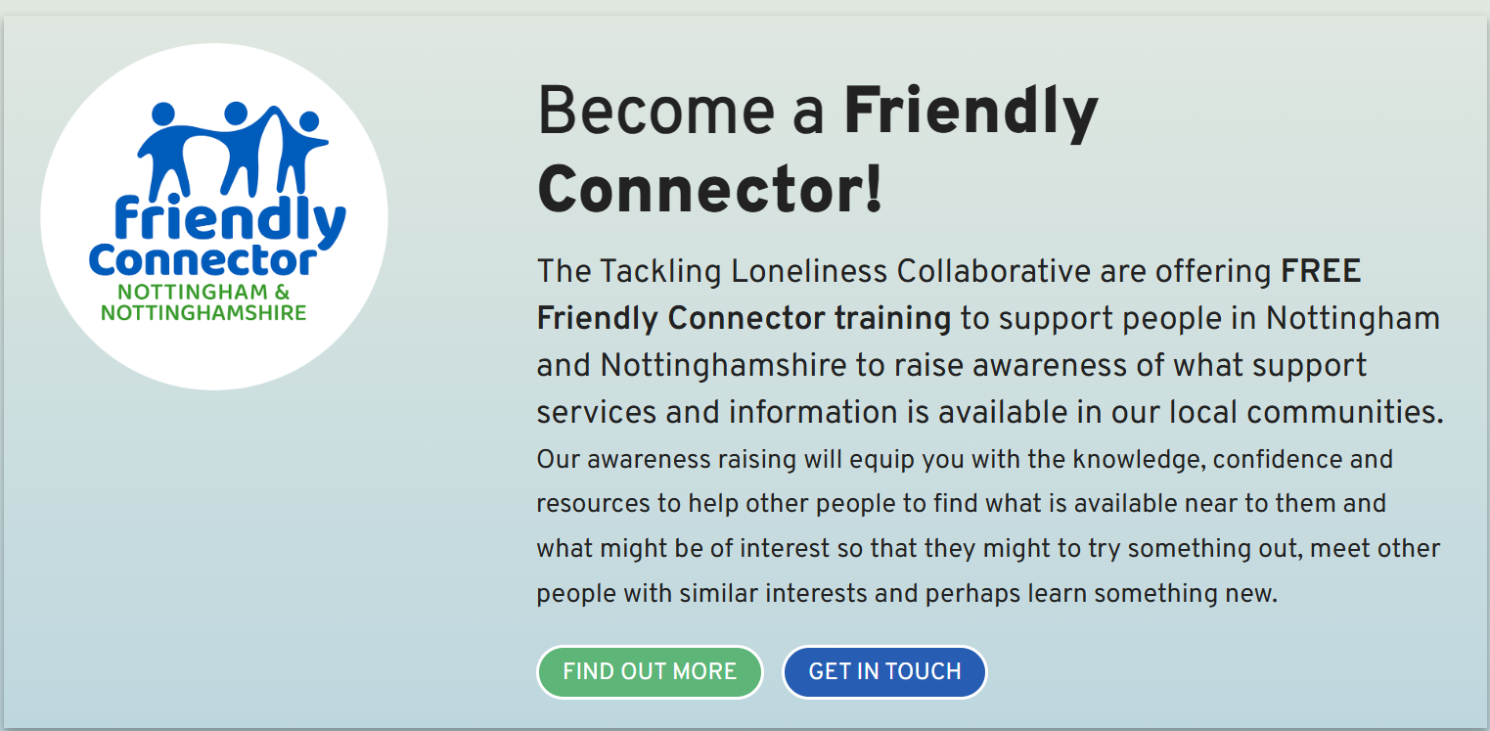

Slide 10
What needs to be included on the TLC Website?
Please write comments down on the papers on your tables

Slide 11
The Autumn of
My Years
A radio play by Henry Dawe

